Slide 1
Data Ingestion JSON And Multiple Files
Submitted By
Maimoona Khilji

Slide 2
Content
Data Ingestion – JSON
Constructors File
Drivers File
Result File
Pit stop File
Data Ingestion - Multiple Files
Lap times
Qualifying

Slide 3
Data Ingestion - JSON

Slide 4
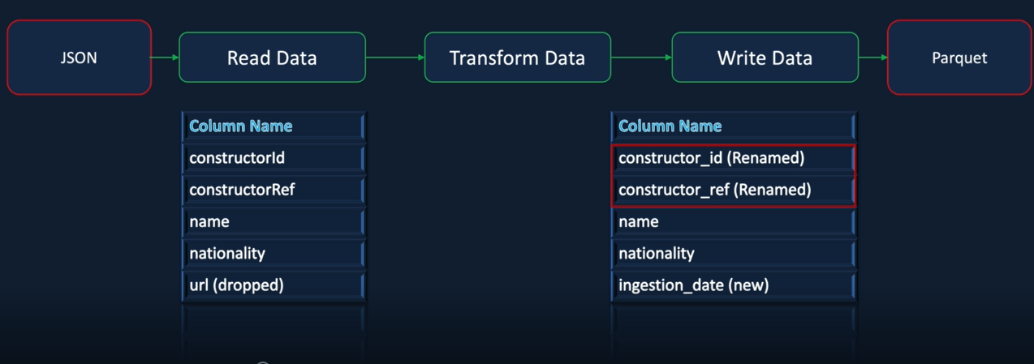
Data Ingestion - Constructors File

Slide 5
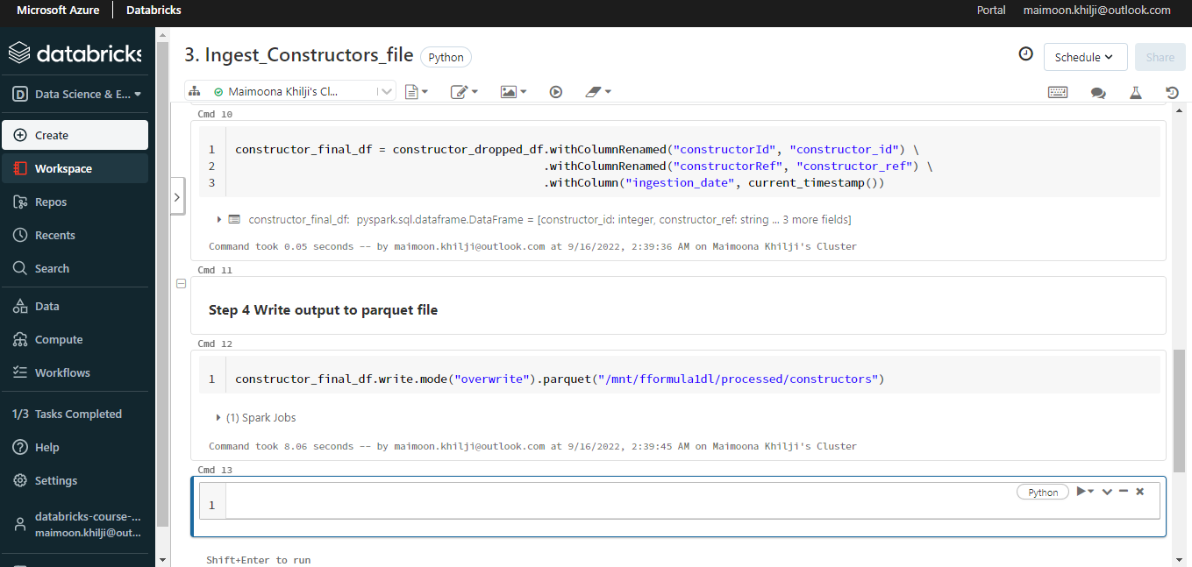
Data Ingestion Constructors.json

Slide 6
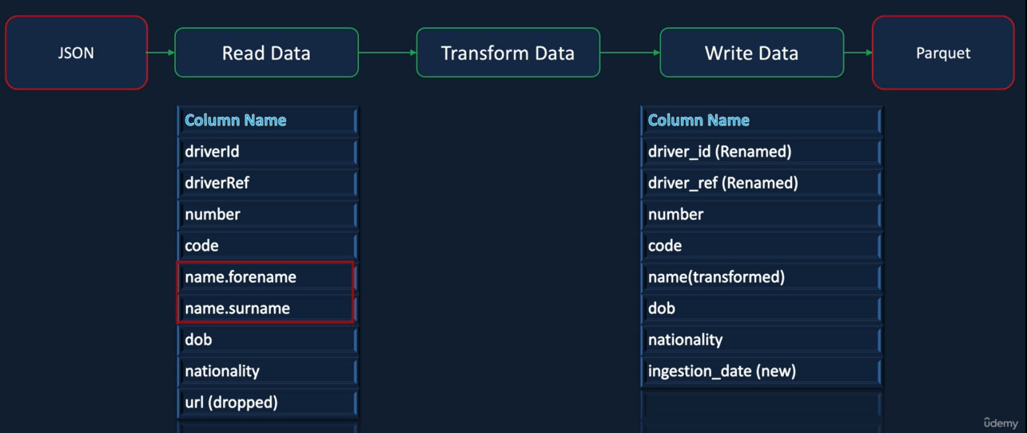
Drivers File - Requirements

Slide 7
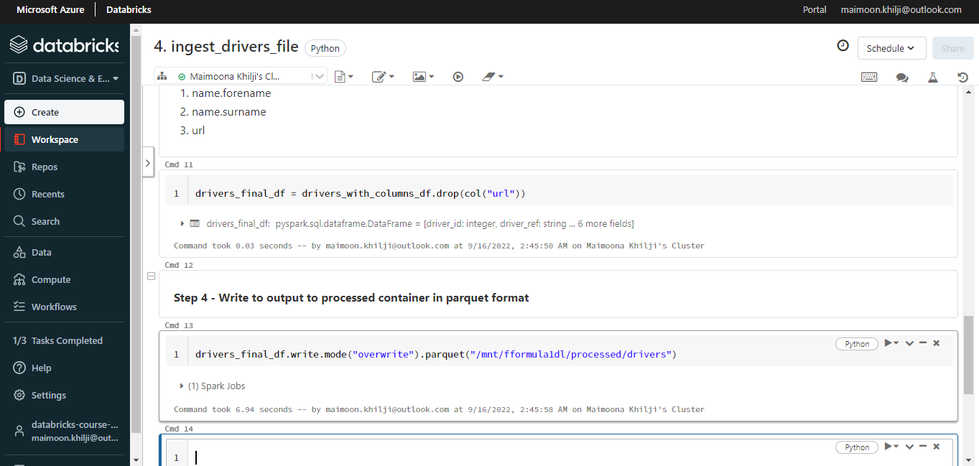
Drivers File - Spark Program

Slide 8
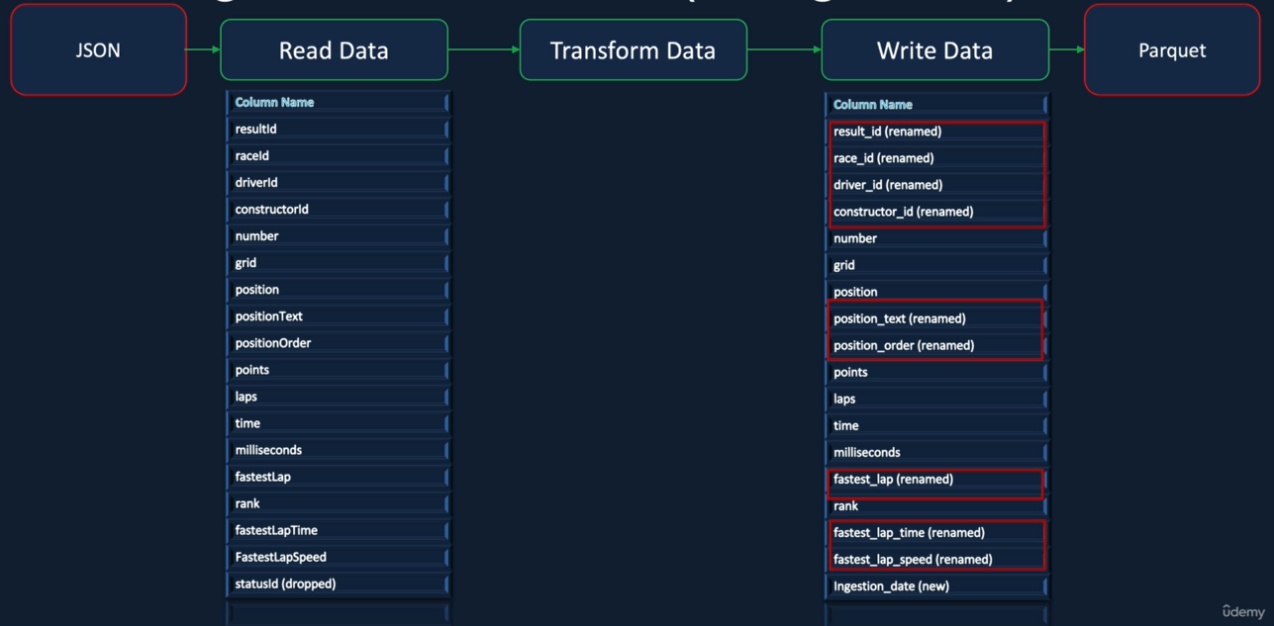
Results File - Requirements

Slide 9
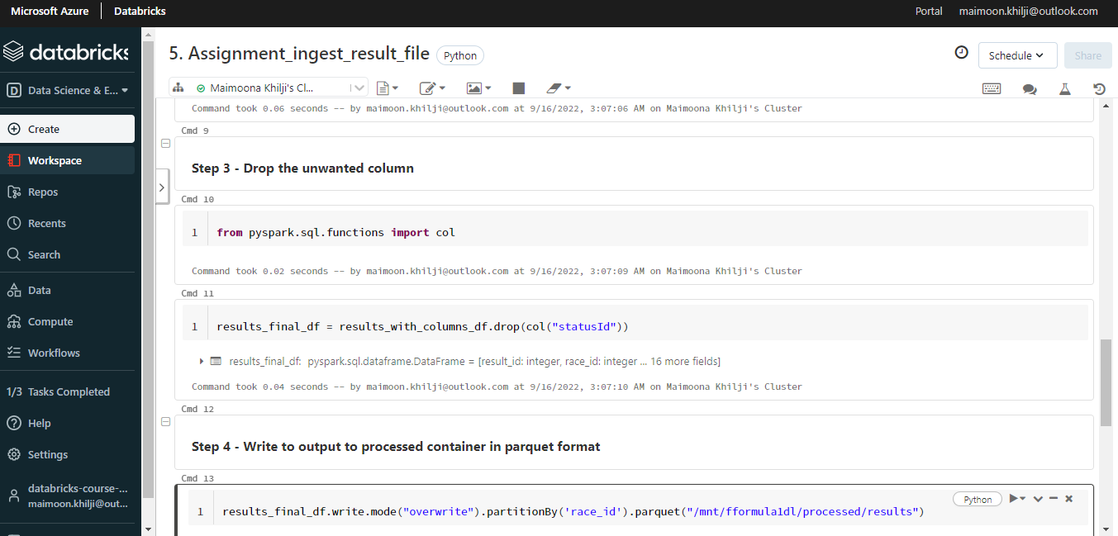
Results File - Spark Program

Slide 10
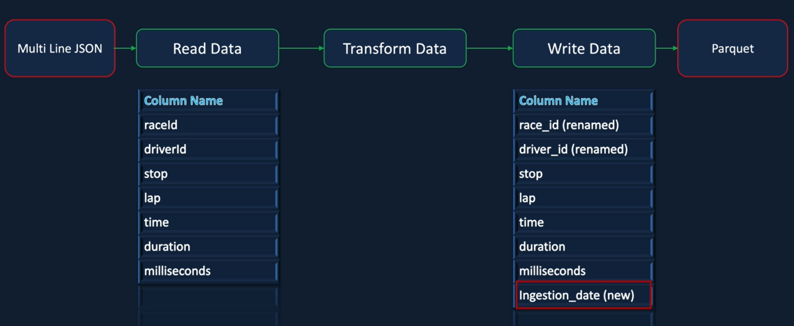
Pitstops File - Requirements

Slide 11
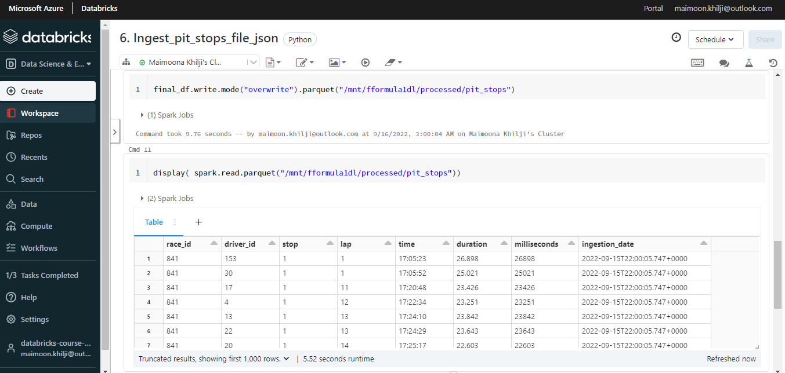
Pit stops File - Spark Program

Slide 12
Data Ingestion – Multiple Files

Slide 13
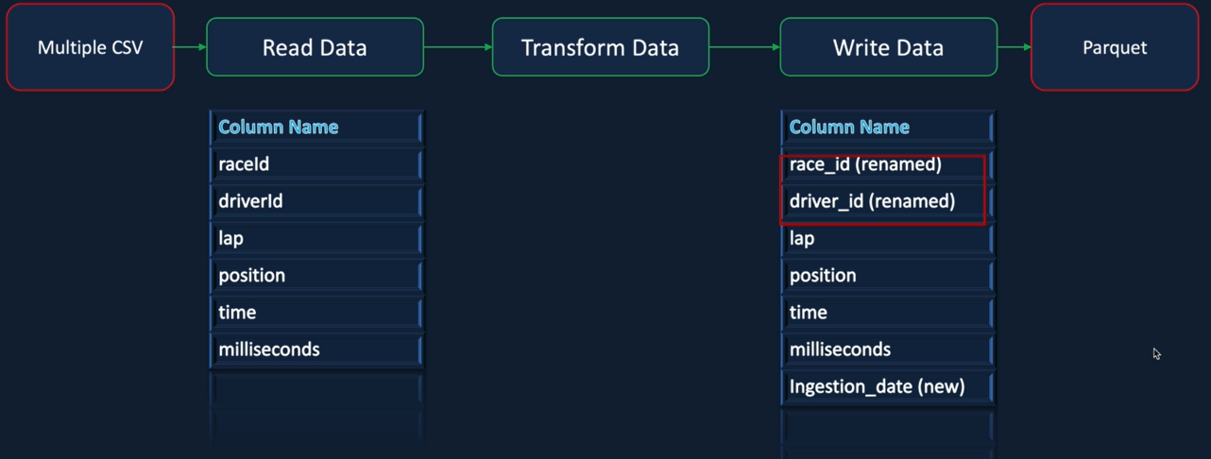
Lap Times - Requirements

Slide 14
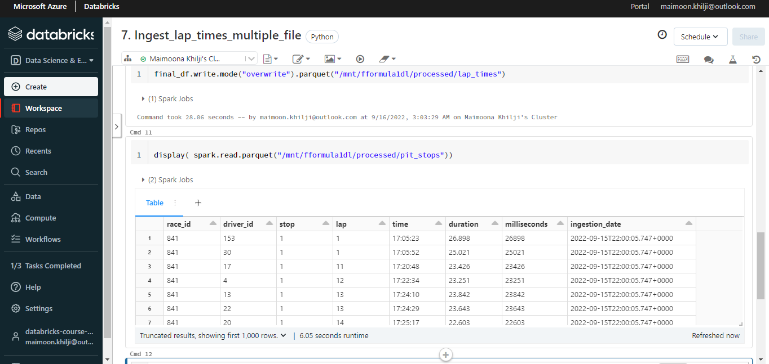
Lap Times - Spark Program

Slide 15
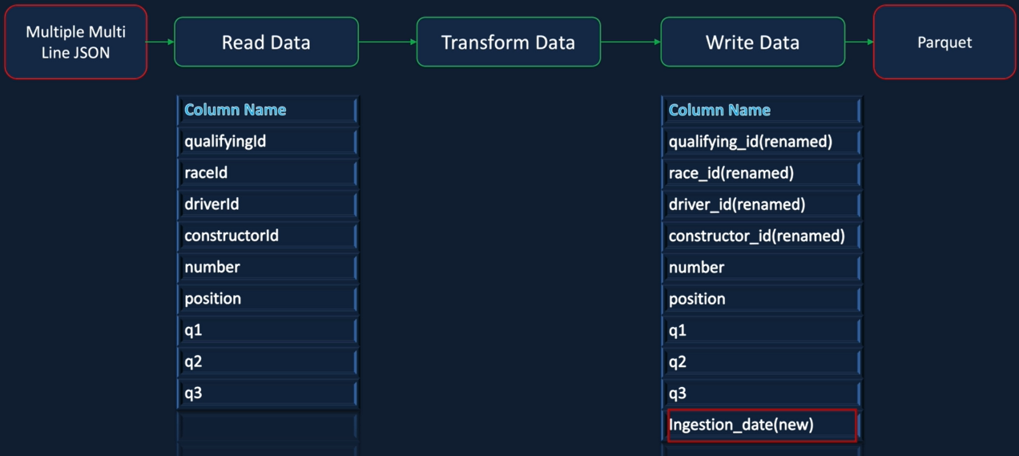
Qualifying - Requirements

Slide 16
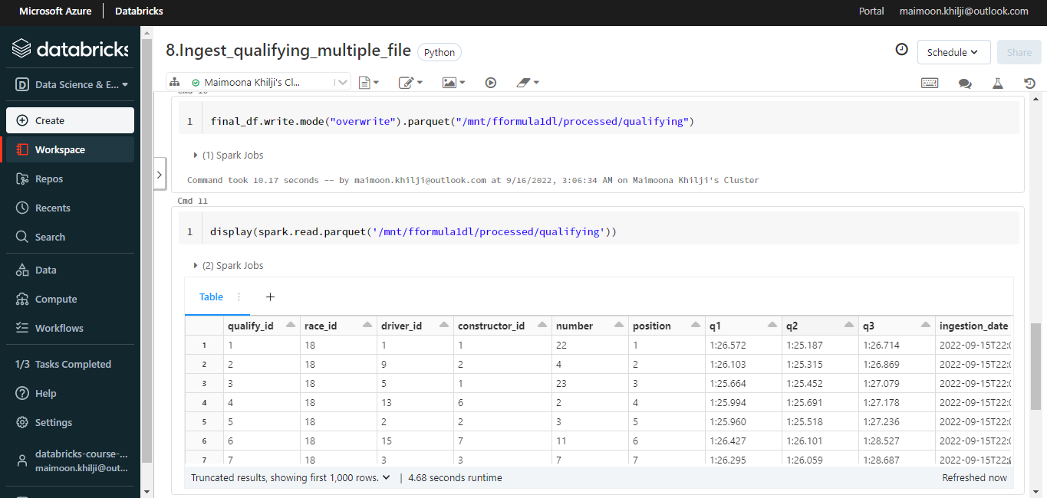
Qualifying - Spark Program

Slide 17
THE END

